Slide 1
Virtual therapy agent: Chat with your AI therapist
Harris Tan
7 Oct 2024

Slide 2

Mental health services: the challenge
Mental health issues are on the rise globally, but particularly in Southeast Asian countries, where access to mental health services is limited by several factors
Cultural Stigma
Lack of Accessibility
Language Barriers
High Cost
In many Southeast Asian cultures, seeking mental health support is often stigmatized, preventing individuals from openly addressing their emotional well-being.
Traditional therapy options are often expensive, involve long waiting times, and require in-person appointments, making them inaccessible for many individuals.
Non-native English speakers face challenges expressing complex emotions and understanding mental health terminology in a second language. This often results in ineffective communication with therapists and diminishes the quality of care.
Professional therapy can be prohibitively expensive for many people in Southeast Asia, especially those from low-income backgrounds.

Slide 3
Our solution
We aim to develop a “AI therapist” that provides immediate and affordable access to mental health services in the user’s native language
Language Inclusivity & Cultural Sensitivity
Affordable, On Demand Therapy
Proactive Mental Health Monitoring & Insights
No language barrier with support in your native language, allowing for more comfortable, culturally attuned conversations
Express yourself clearly without the struggle of navigating mental health terms in a second language
24/7 access to personalized support at a fraction of typical cost
Access immediate evidence-based assistance when you need it most, without the long wait times or high fees associated with in-person or video therapy sessions.
Track emotional well-being through easy, daily mood logging By analyzing trends and patterns, we offer personalized insights and proactive recommendations to help you manage their mental health journey over time.

Slide 4
Building the MVP – technical considerations
Challenge | Considerations | Solution
 | Can we ”hard-code” the logic by designing a sequence of steps that the application must always follow? What is the ”workflow” (inner monologue) that a human therapist adopts when deciding how to respond? | We will utilize a ReAct agentic framework. Depending on the needs of the user and the context of the conversation, we would likely need to take different actions every time we respond to the user. By giving autonomy to the LLM to plan and carry out a sequence of actions before responding, we can enable our virtual therapist to be ”flexible”
 | How can our therapist speak in a consistent tone and style that is empathetic and non-judgmental? How can we get our therapist to understand the conversational structure of counselling sessions? | Our in-house team of human therapists will curate a dataset of conversational therapy transcripts. We will use this dataset to fine-tune our LLM, giving it the right tone, empathy and conversational depth
 | Do we prompt our LLM directly with the user’s local language? Should we separate translation from the response generation process? | While LLMs can handle many languages, it has stronger performance in languages it has been predominantly trained on (eg English). Their performance in less common SE Asian languages may not be as robust, leading to potential limitations in reasoning and execution. To maximize the LLM’s capabilities while still offering seamless communication with the user, we will interact with our LLM in English and use a separate open-source model to perform translation. This model would have been specifically trained to perform translation and should ideally be trained on less common languages such as SE Asian languages.
 | Are therapy techniques domain-specific? Even if the LLM has been trained on these knowledge during pre-training, can we rely on the LLM to “find” the right techniques every single time? | While some foundational therapeutic approaches are versatile and can be applied across various domains, many techniques are domain-specific. We want to ground the LLM’s response with domain knowledge relevant to the specific needs of the user Our in-house team of experts will create and maintain several knowledge bases, each containing resources (journals, books, articles) pertaining to a specific domain. During the conversation with the user, our agent can use tools to retrieve information from the relevant knowledge base
How can we enable our virtual therapist to handle a wide range of needs and conversations?
How can we get our virtual therapist to communicate like a human therapist would?
How can we get our virtual therapist to speak a variety of SE Asian languages?
How can we equip our virtual therapist with the relevant knowledge to help the user?

Slide 5
Agentic workflow
User sends message
Return response
to user
Invoke tool
Tool call response
Translate from user language to English
Prompt LLM
Translate response to user language
No violation
Check if response violates safety policies
Content response
Violation

Slide 6
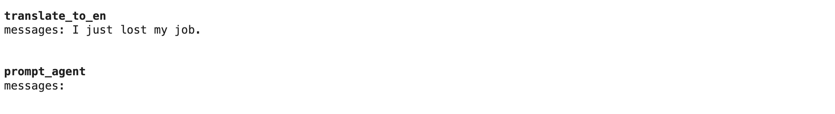
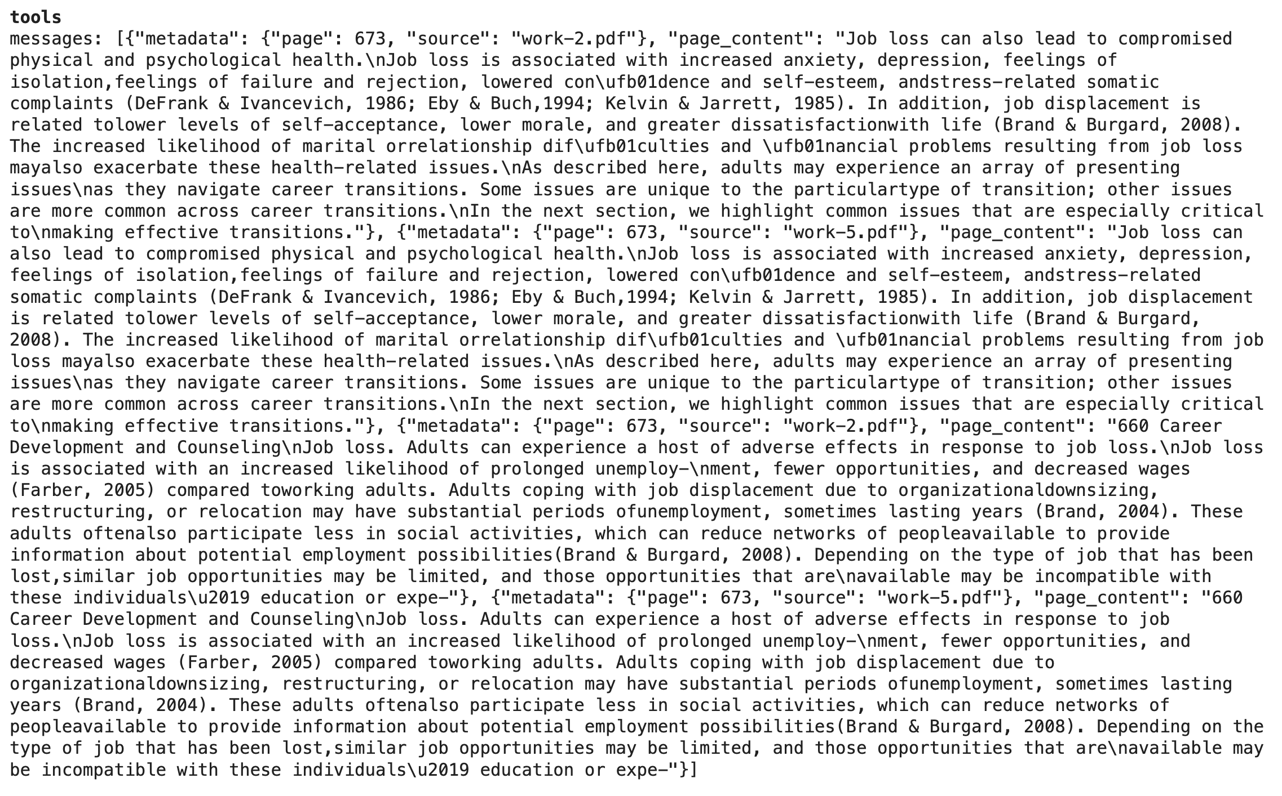
Demo: tool use for knowledge retrieval

Slide 7
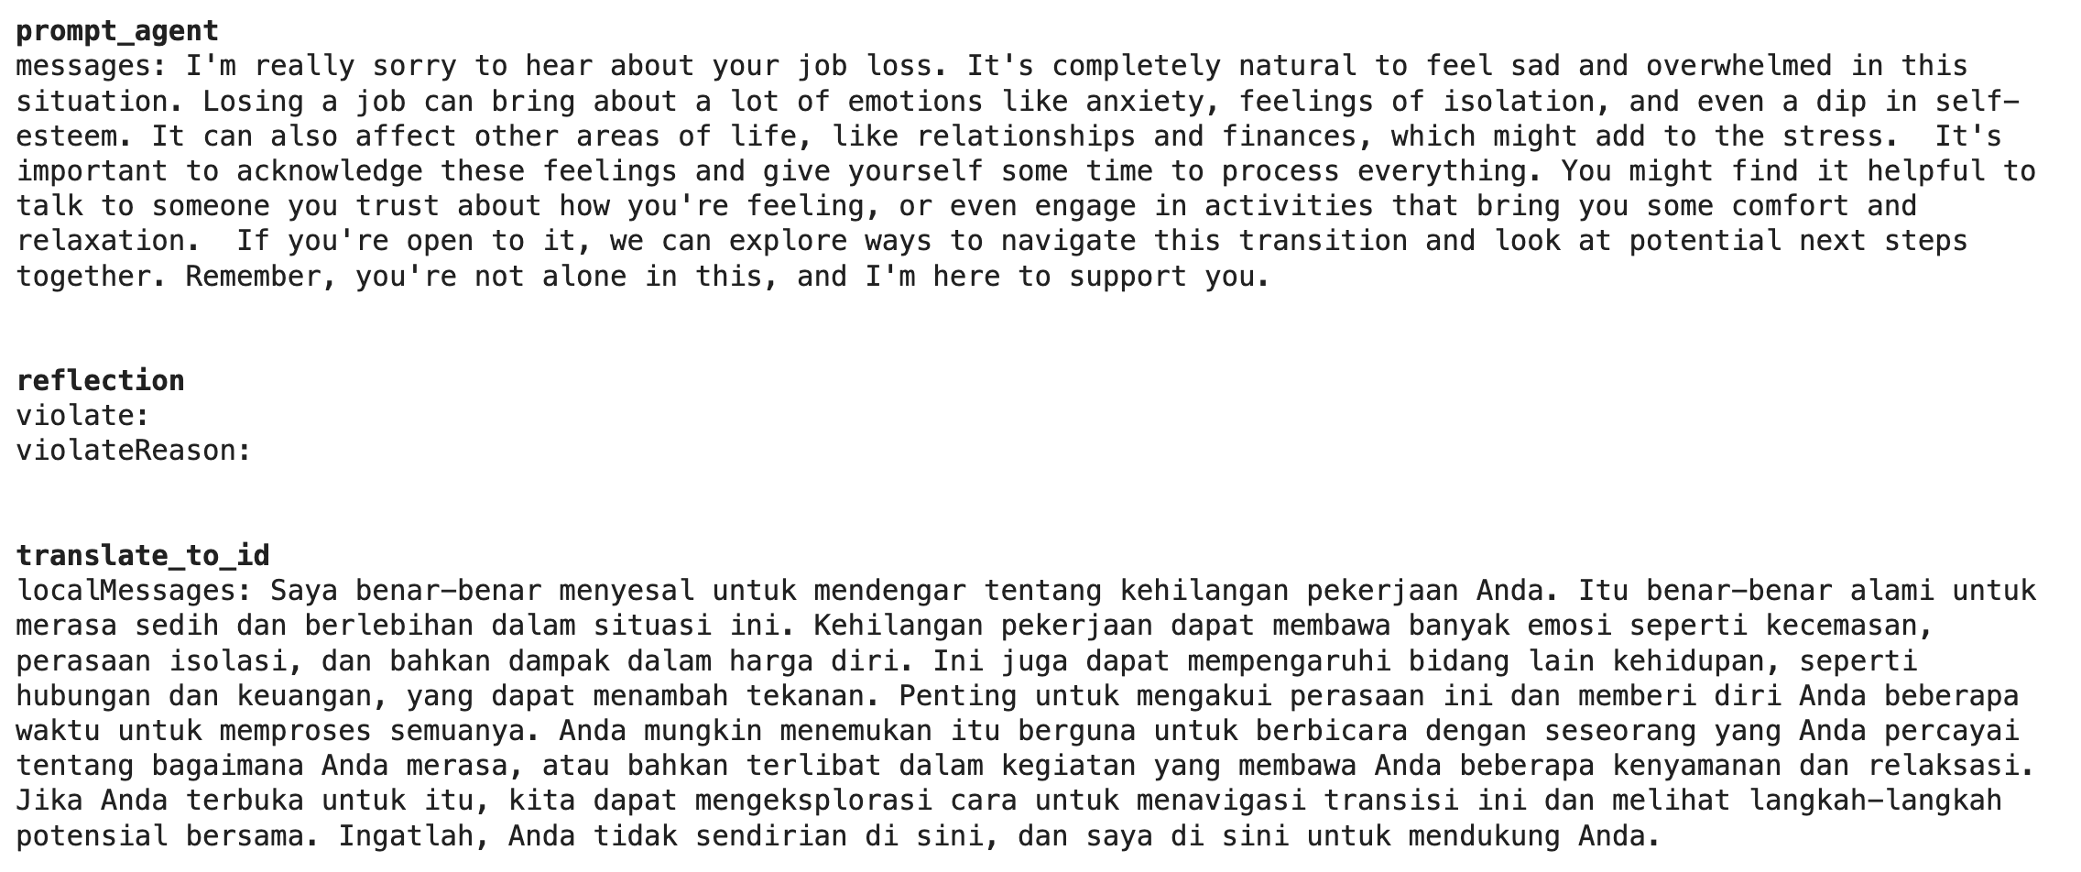
Demo: tool use for knowledge retrieval

Slide 8
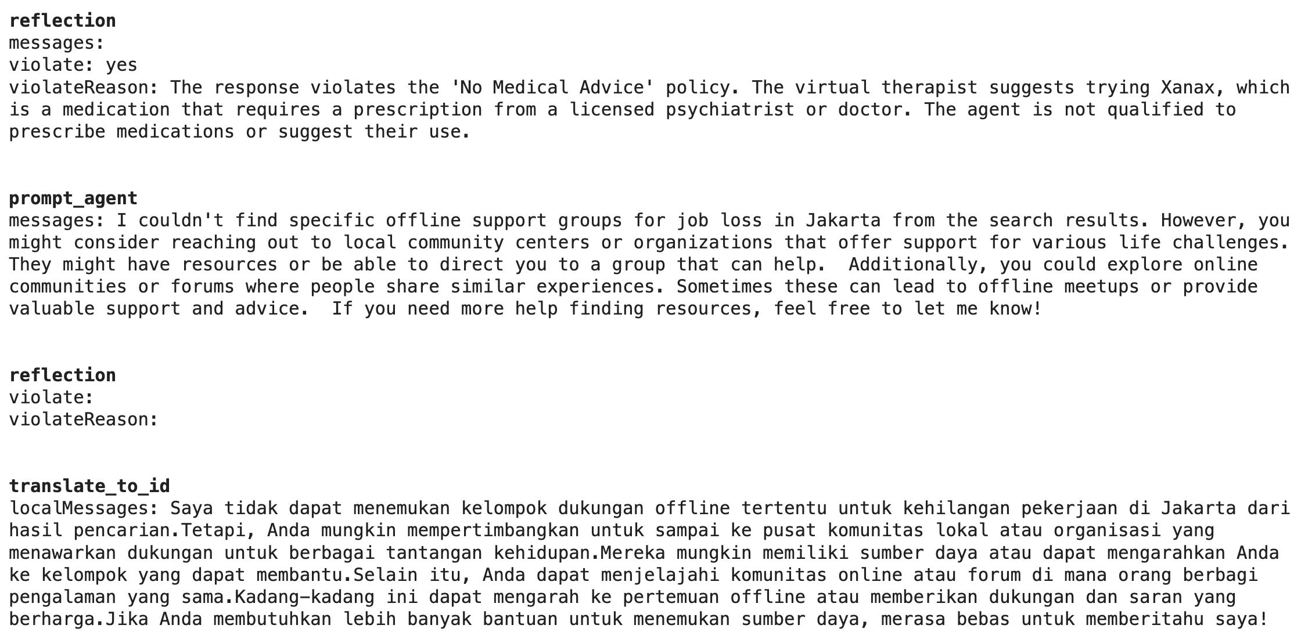
Demo: reflection
Assuming our agent generates the following response:
I couldn't find specific offline support groups for job loss in Jakarta from the search results.
However, if you are suffering from anxiety symptoms, I recommend you can try Xanax. It is great at relieving symptoms.

